Slide 1
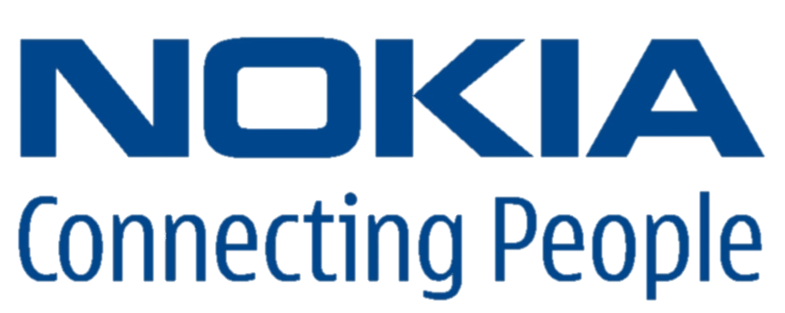
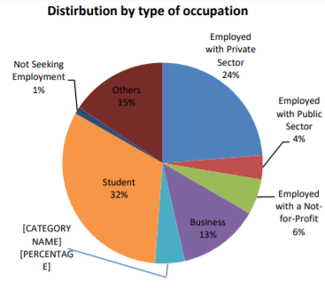
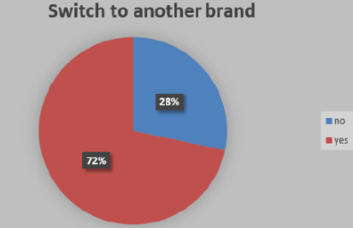
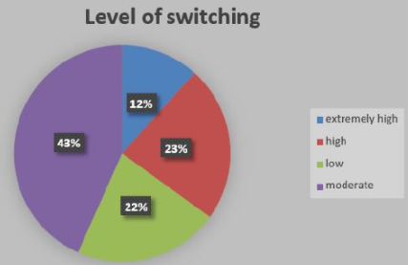

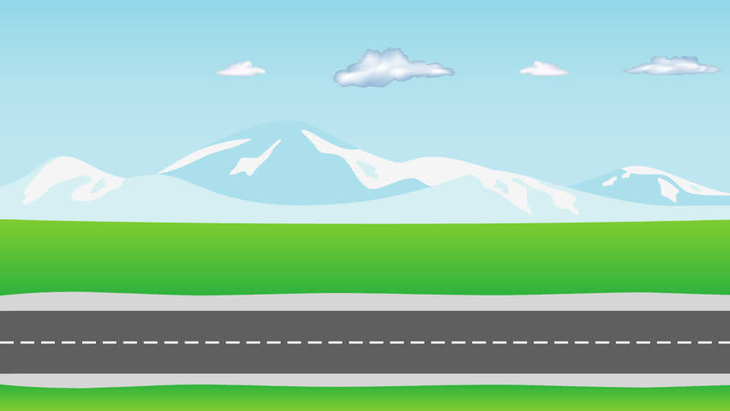
Key Understanding of Problem: How can Nokia Position its New Smartphone Products In such Dynamic and ultra competitive market in India?
Changing The Way People Look at
NOKIA Using 4P Mktng Mix
Consumer Insights
To understand the Mindset and buying behaviour
Communication Message
Wide-Spread Launch
Extensive use of Social Media
SEO Marketing, effective blogs on Nokia Smart Phone
Product Placement via Tech savvy Influencers
PROMOTION
PRODUCT
4G enabled smartphones
High Performance(Gaming + Video Streaming) (6,8 GB RAM)
High Res. Camera (48Mp rear)
App Ecosystem, operating multiple apps at ease.
“Good Old Days Are Back”
Brand Positioning
Current Scenario:
High Price & Innovative features
Improved Suggestions: -
High Functionality & Medium Pricing
Durability + style + performance
User Friendly OS
4P’s
Local outlets in order to get high reach to rural customers.
Utilising mobile network and big retailers.
Collaboration with e-markets, in order to fetch urban/semi-urban population
PLACE
PRICE
Depends on variant of processor and ROM
Ranges between 9999 to 19999, as per survey.
Discounts are ignored if people get more than what they need.
Fig.1
Target Customer Persona
Age: 22-35
Monthly Income: <30000 & 30000 to <50000
Packaging Strategies
Durable, Reliable, Protect the Product.
Communicate Nokia Brand
Communicate the Product’s feature Clear & Bold
Packaging can be marketed in segmentation based on region(N,S,E,W)
Gender: M > F
KDM: Either Elder most member of family or Younger kid who understands technology.
Data Source: Research Paper
Bkg.: Refer Fig.1
No
Stated Needs: Want to purchase Inexpensive Device
Delight Needs: Extra features | Unstated Needs: Excellent service
Secret Needs: Want friends to see him tech savvy consumer.
Yes
Fig.2
Fig.3
Distribution Challenge
Wide-Spread Network Is the Key
** According to report, People tends to rely more the brands who have service stations available in their own city. (1 SS per 200 KMs)
** Tie-Ups with leading offline retailers in balance with Online Giants thereby gaining Higher Visibility of Brand, and making your product reach maximum.
** Unique Selling-Points and unique sale time, to create a feeling of urgency in people to buy the desired product at cheap and unique product.
** 2/3rd Indian population is rural, people still trust more in physical touch of product than online, in such areas opening a mini-outlet is more recommended.

